Slide 1
10.15 Meeting - 4
吳定洋
1

Slide 2

Table of contents
01
02
RTT Device
Wi-Fi CSI traffic APP
2

Slide 3

01
RTT Device
Device we can buy
3

Slide 4
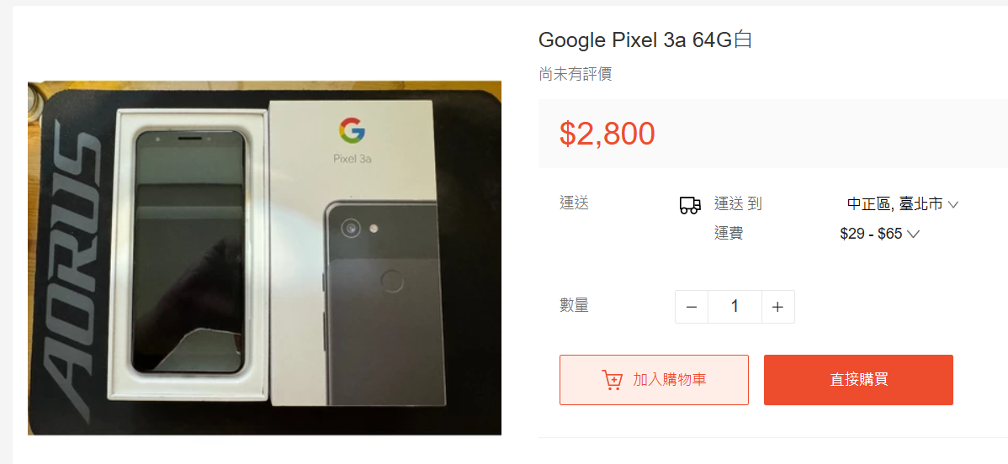
Google Pixel 3a
4

Slide 5
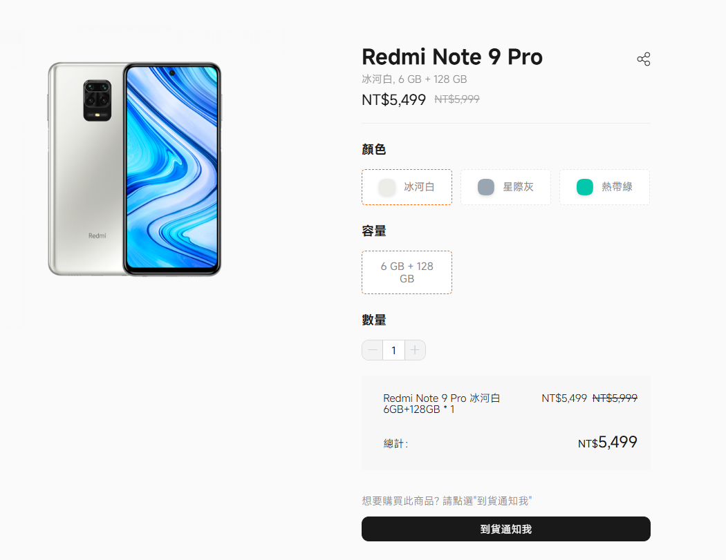
Xiaomi Redmi Note 9 Pro
5

Slide 6
Other device
https://developer.android.com/develop/connectivity/wifi/wifi-rtt?hl=zh-tw
目前看到小米有支援 RTT 的價格大概在 5000 多
不過很多都下架了可能不一定能從官網買
6

Slide 7

02
Wi-Fi CSI traffic APP
7

Slide 8
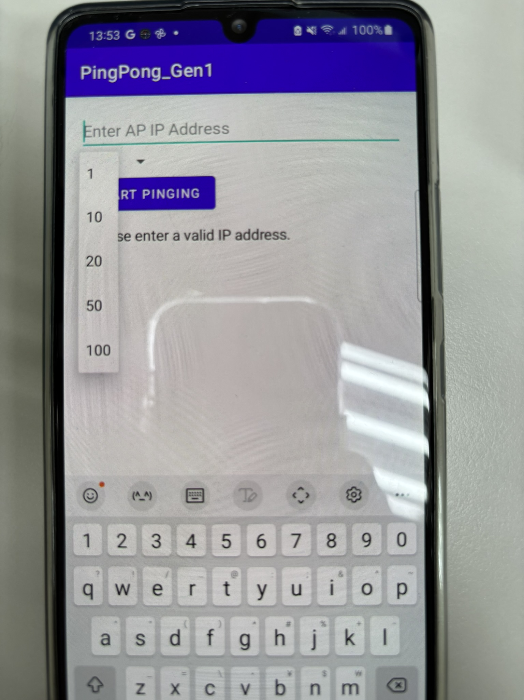
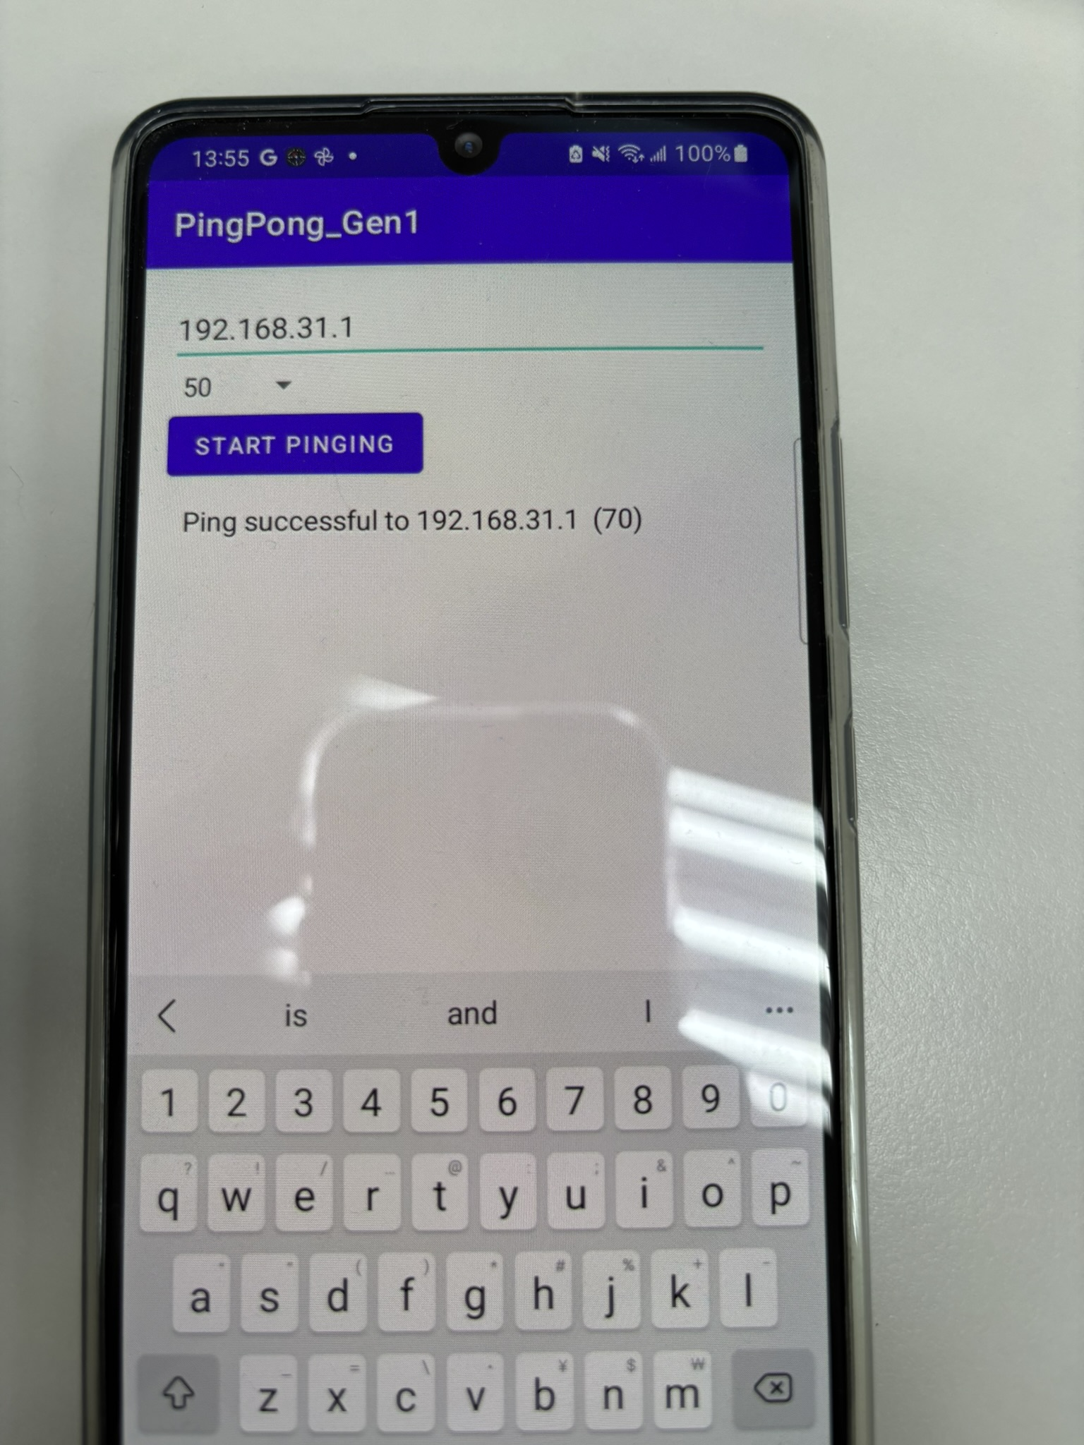
APP
8

Slide 9

Thanks for Listening!
9

